Slide 2
NYC Taxi Trip Data Analysis: A Machine Learning Perspective
Bharath Reddy Emani | bemani@kent.edu
Deekshith Venepally | dvenepal@kent.edu
Indira Devi Galla | igalla@kent.edu

Slide 3
Contents
Abstract
Introduction
Objective
Project Explanation & Code
Results

Slide 4
Abstract
The demand for taxis fluctuates significantly across different locations and times of day, posing challenges for efficient fleet management and resource allocation.
Leveraging historical taxi trip data, this research explores the application of time series analysis and machine learning models to forecast taxi demand.
By accurately predicting demand patterns, taxi companies can optimize fleet deployment, improve service efficiency, and enhance customer satisfaction.
This study presents an integrated framework for forecasting taxi demand, incorporating various features such as pickup/dropoff locations, time of day, and historical demand trends.
The results demonstrate the potential of the proposed approach in enhancing taxi service operations and resource allocation strategies.

Slide 5
Introduction
This research aims to address this challenge by investigating the application of time series analysis and machine learning models to forecast taxi demand at various locations and times of day.
By analyzing historical trip data, including pickup/dropoff locations, timestamps, and passenger counts, we seek to develop predictive models capable of capturing the complex temporal and spatial patterns in taxi demand.
The ultimate goal is to provide taxi companies with actionable insights that can inform fleet management decisions, improve resource allocation, and enhance overall service quality.

Slide 6
Objective
The primary objective of this project is to develop a predictive model for forecasting taxi demand based on historical trip data. Specifically, the objectives include:
Data Preprocessing: Clean and preprocess the historical taxi trip data, including handling missing values, outliers, and feature engineering.
Exploratory Data Analysis: Conduct exploratory data analysis to gain insights into the temporal and spatial patterns of taxi demand, identifying key factors influencing demand fluctuations.
Model Development: Develop and train time series analysis and machine learning models to forecast taxi demand at different locations and times of day.
Model Evaluation: Evaluate the performance of the developed models using appropriate metrics, such as mean absolute error (MAE) and accuracy.

Slide 7
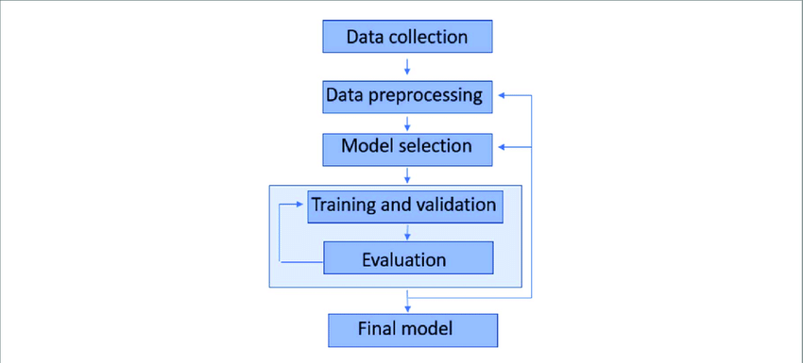
Project Design

Slide 8
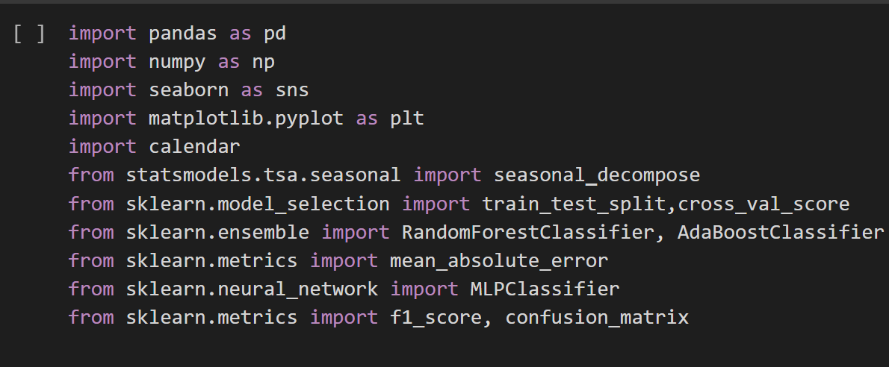
Project Code
Importing required libraries for the data
Loading the data

Slide 9
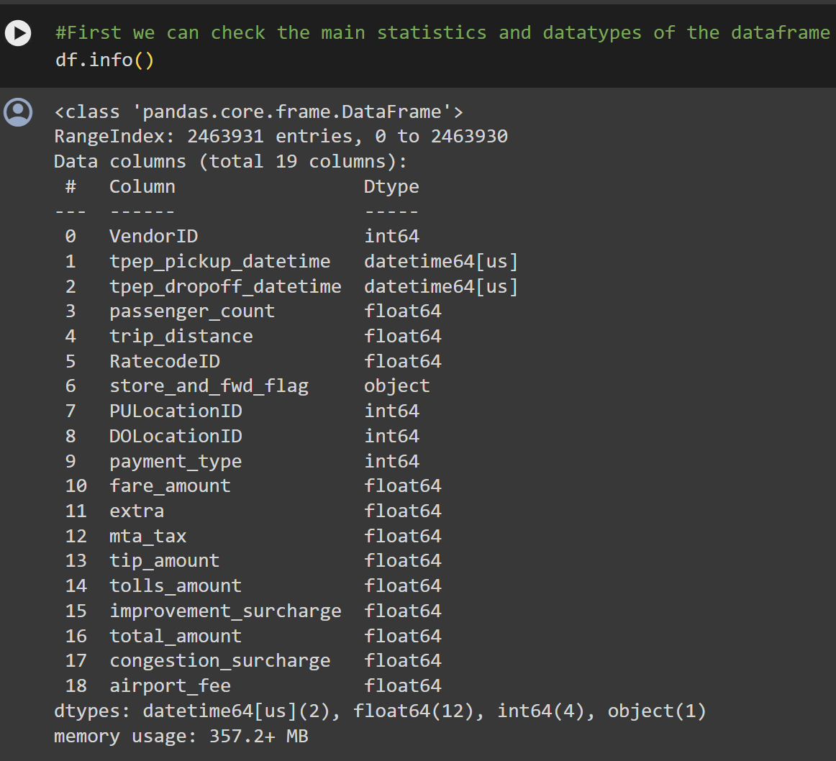
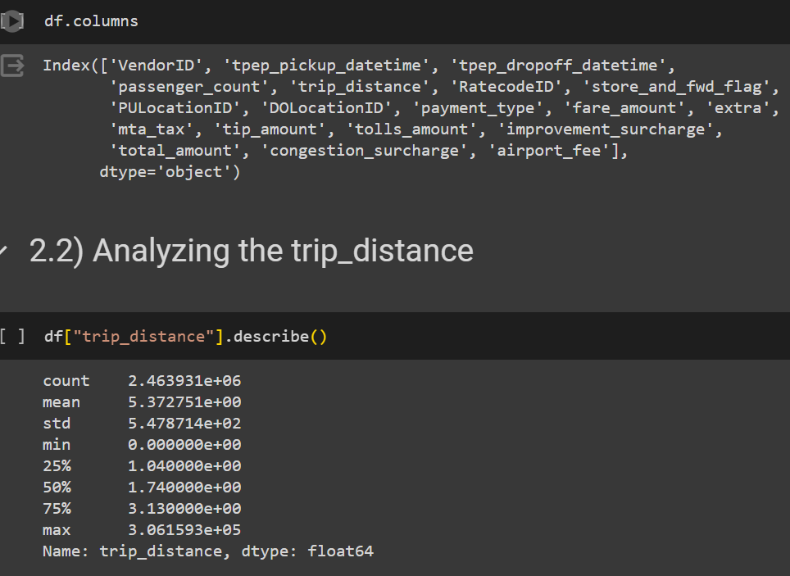
Project Code
Analyzing the data.

Slide 10
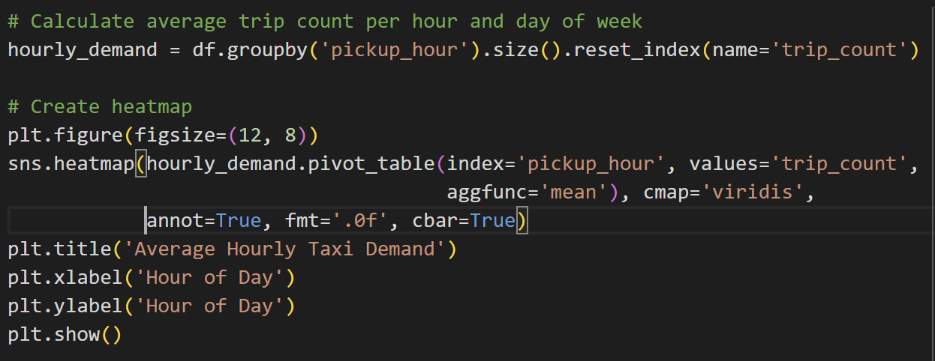
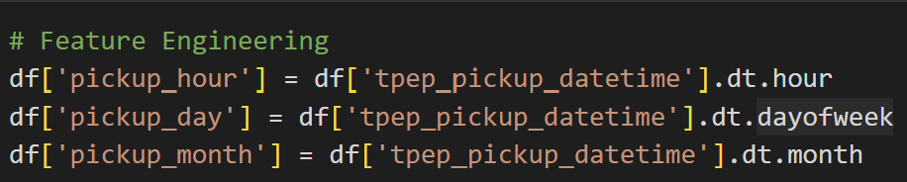
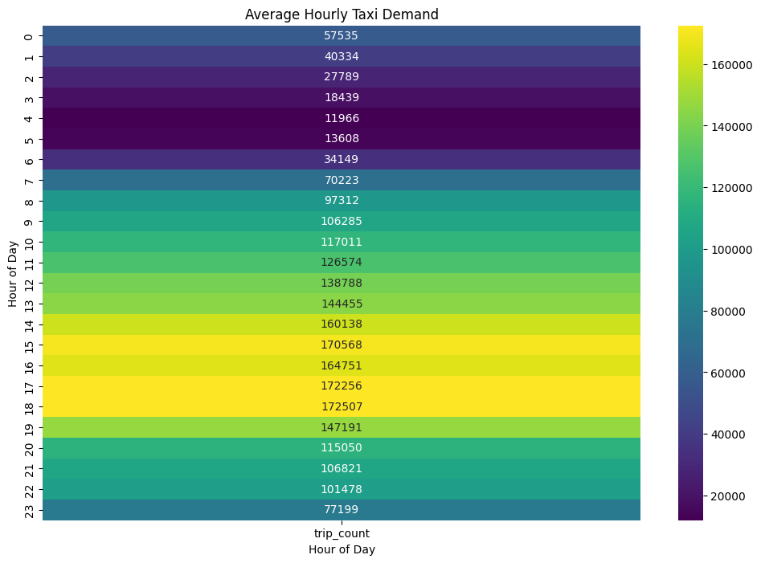
Project Code
Feature Engineering
Visualizations
Output

Slide 11
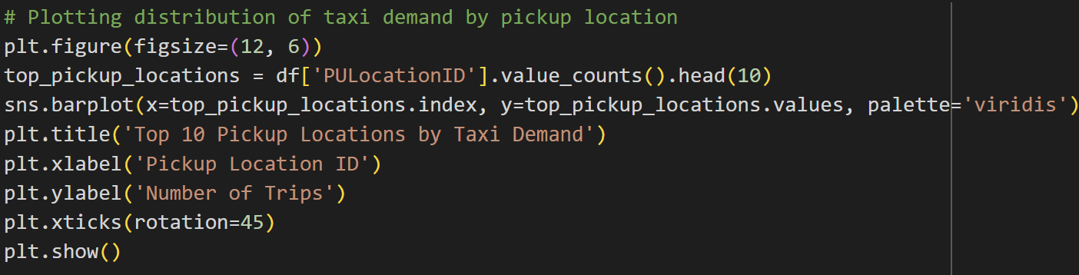
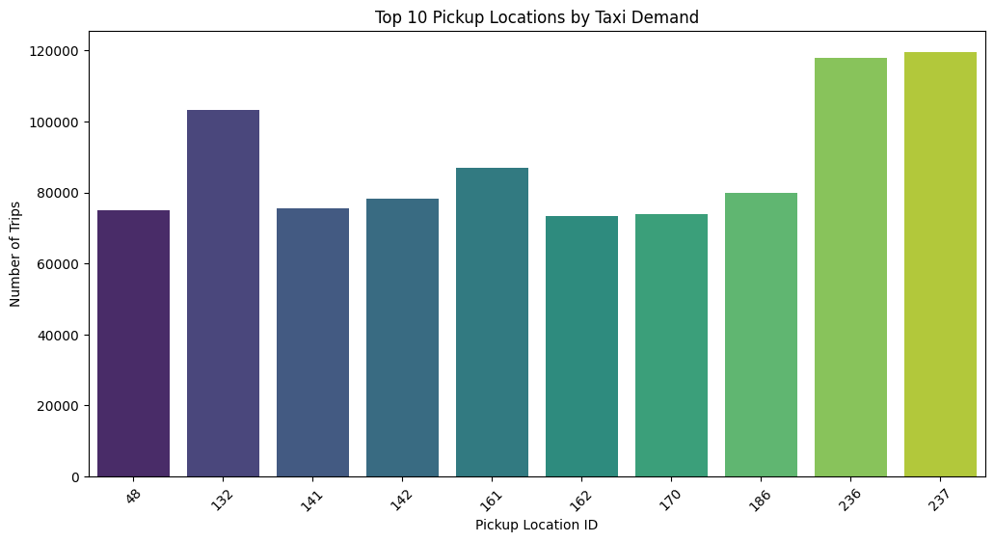
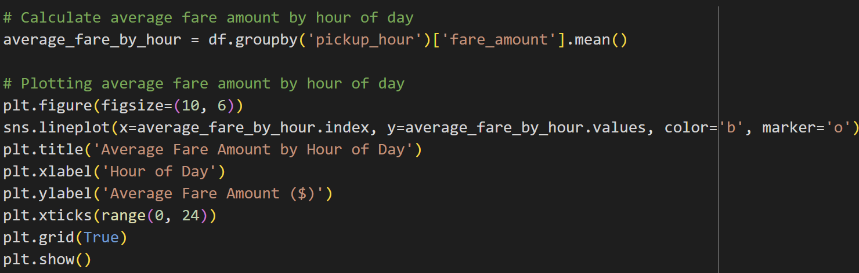
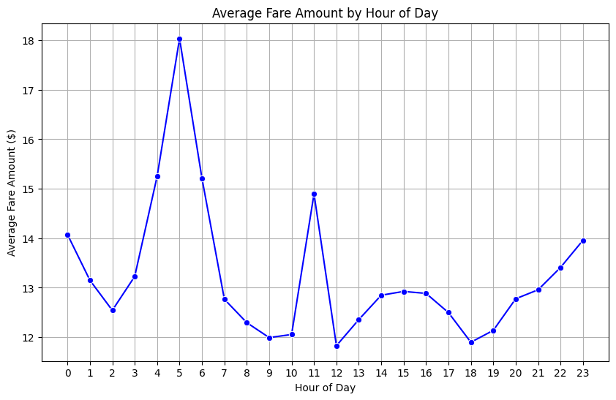
Visualizations

Slide 12
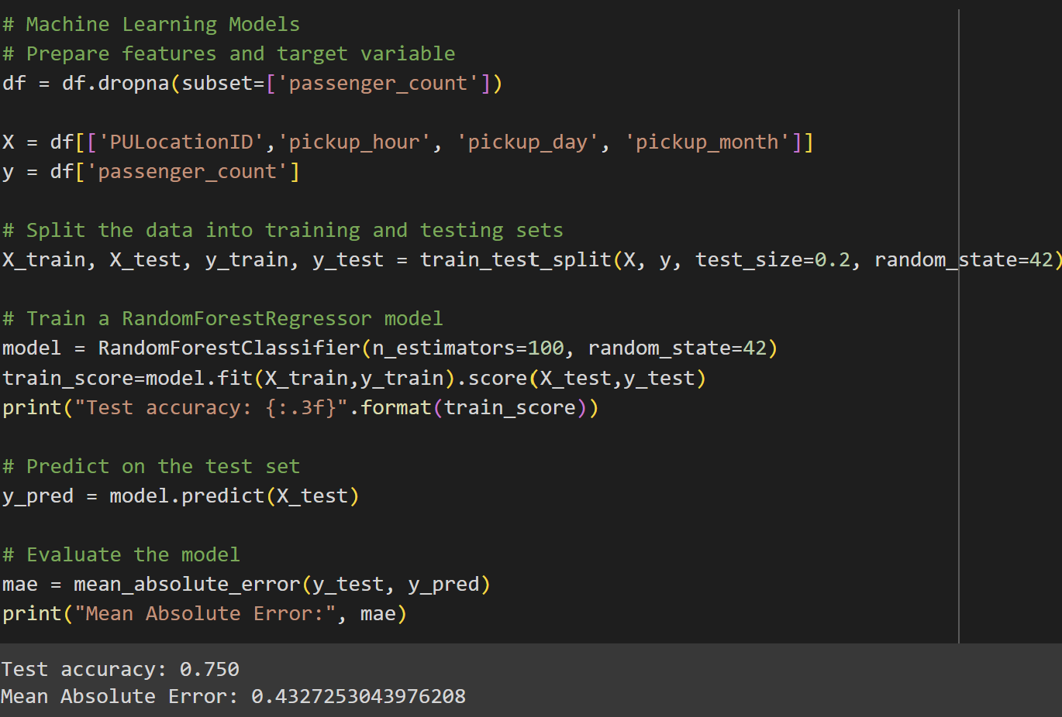
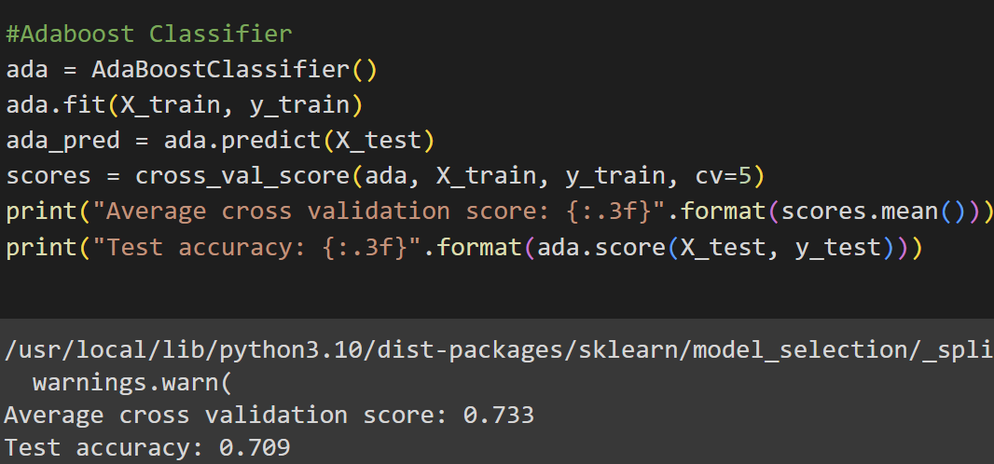
Models
Random Forrest Classifier ADA Boost Classifier
The output indicates that the average cross-validation score is approximately 0.733, and the test accuracy is approximately 0.709. These scores provide an indication of how well the AdaBoostClassifier model generalizes . Both scores are slightly lower than those achieved by the RandomForestClassifier in the previous code section, suggesting that the RandomForestClassifier may perform slightly better on this particular dataset.
The output indicates that the model achieved a test accuracy of approximately 75% and a Mean Absolute Error of approximately 0.43. The accuracy score reflects the proportion of correct predictions made by the model, while the Mean Absolute Error gives an idea of the average magnitude of the errors made by the model in predicting the number of passengers.

Slide 13
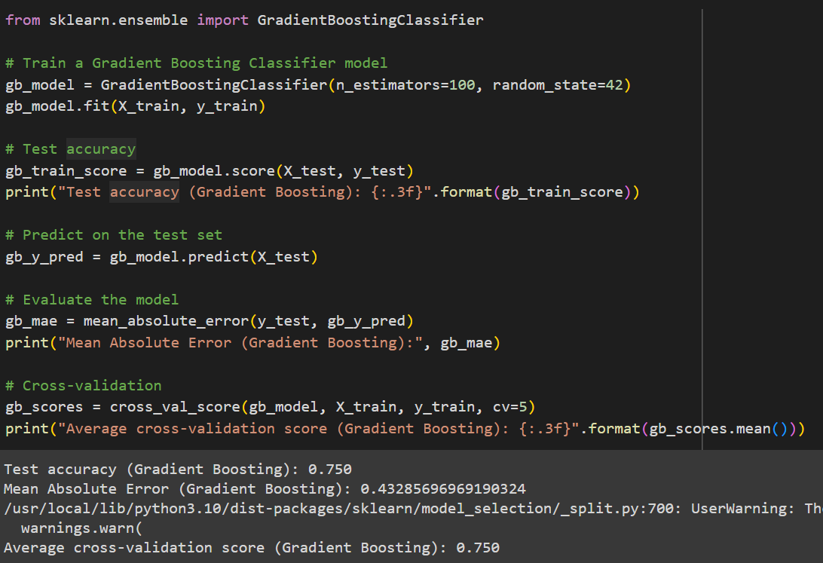
Models
Gradient Boosting Classifier
The output indicates that the test accuracy of the Gradient Boosting Classifier model is approximately 0.750, and the Mean Absolute Error is approximately 0.433. These results are comparable to those obtained by the RandomForestClassifier. Both models seem to perform similarly well on this dataset.

Slide 14
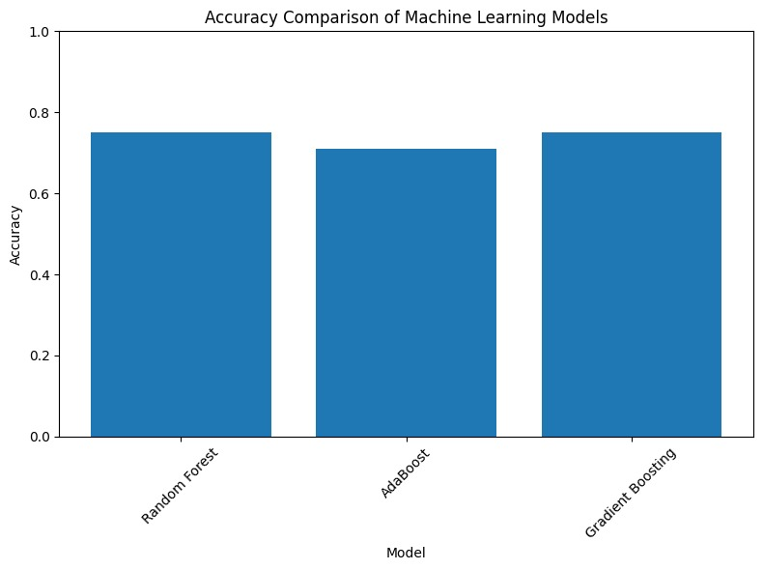
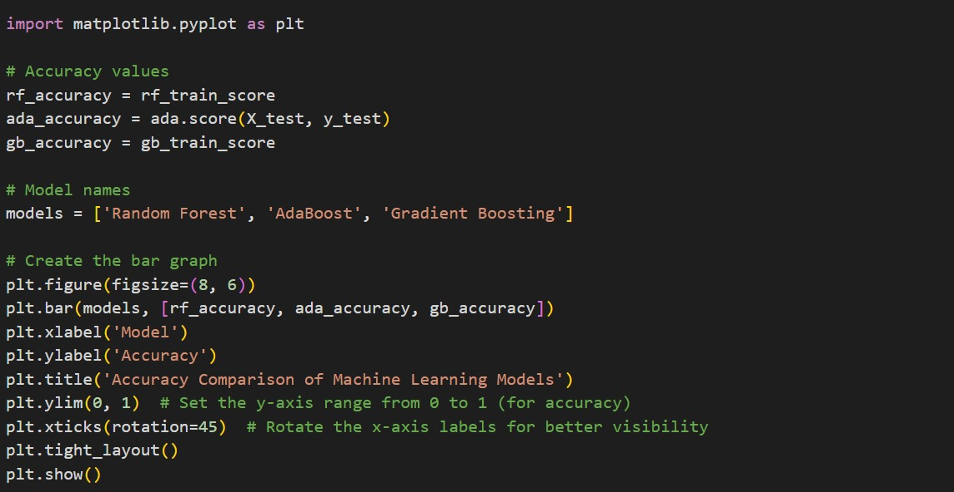
Models Comparisions

Slide 15
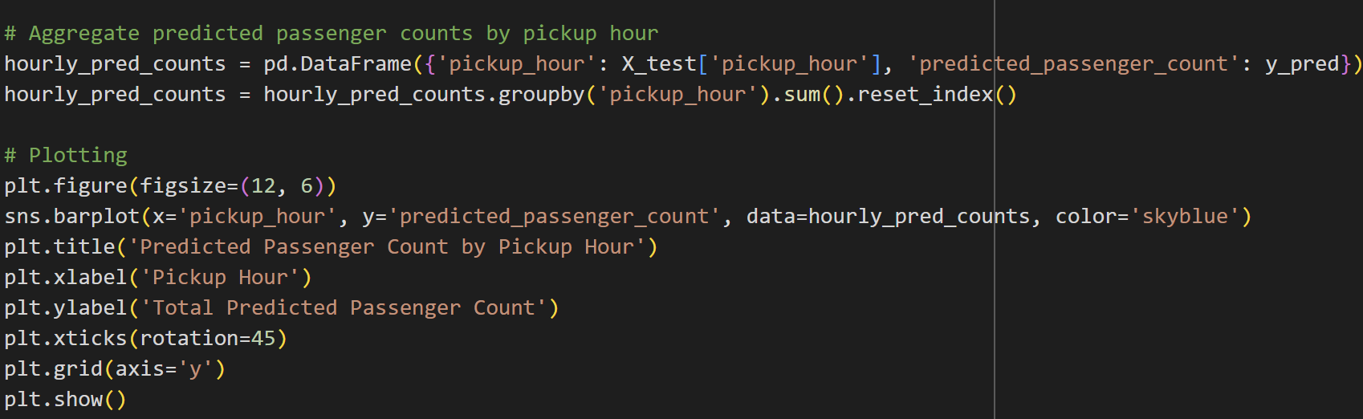
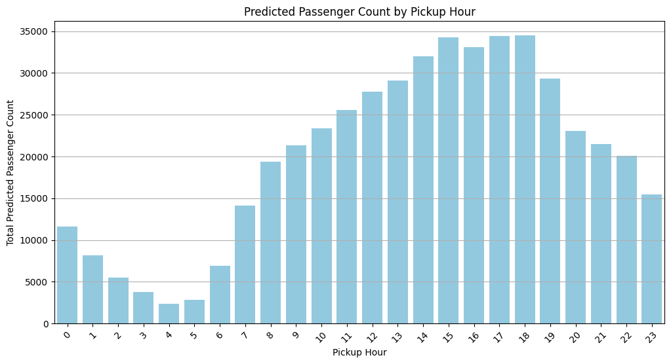
Model Predictions

Slide 16
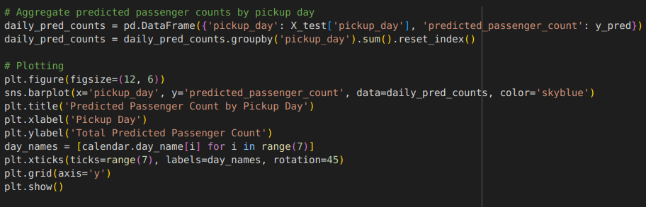
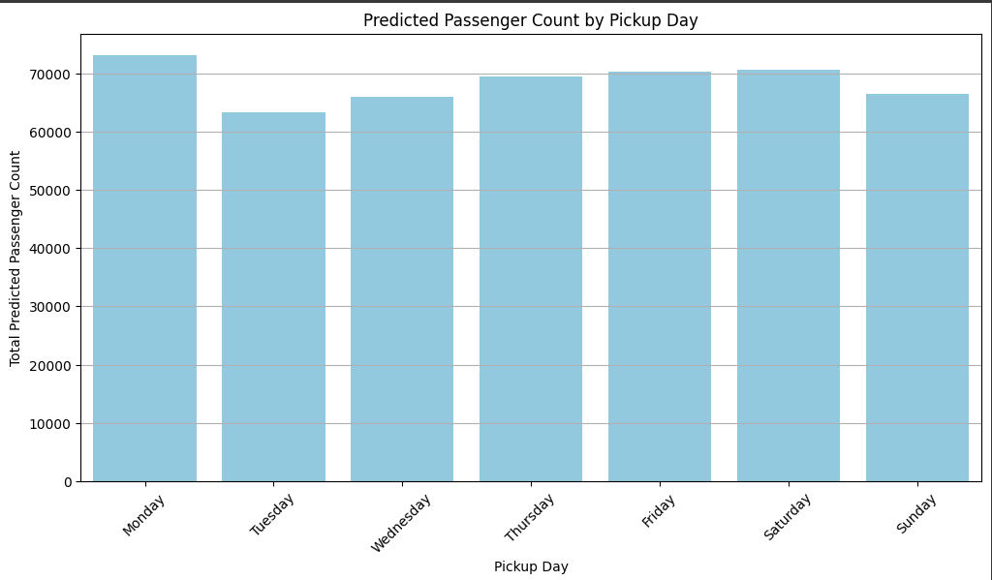
Model Predictions

Slide 17
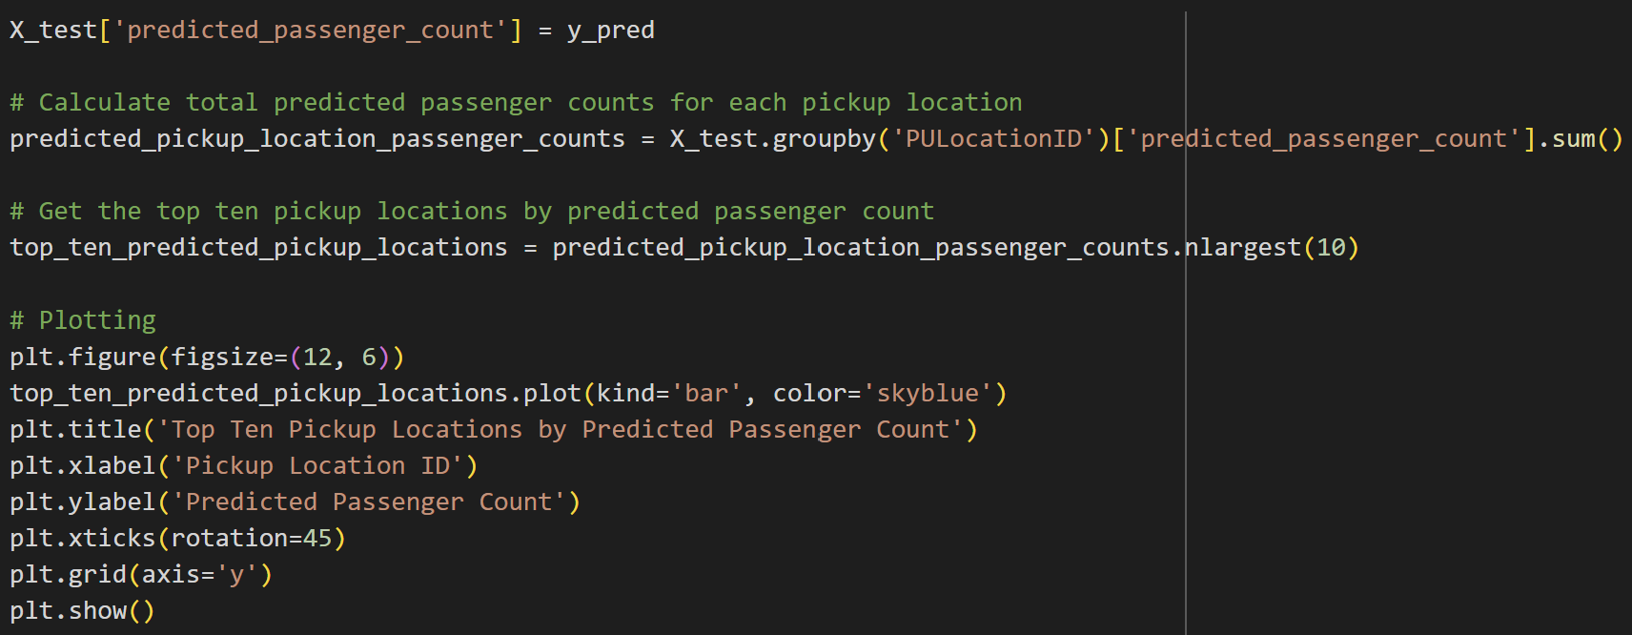
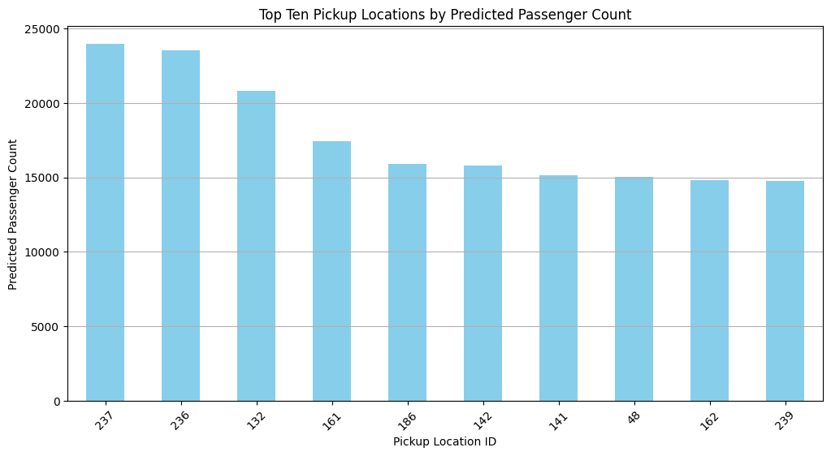
Model Predictions

Slide 18
Results
Average Cross Validation Score: The average cross-validation score of 0.733 indicates the overall performance of our Adaboost model across different folds of the dataset during cross-validation. This score suggests that your model is reasonably accurate in predicting taxi demand.
Test Accuracy: The test accuracy of our model 0.709 indicates the proportion of correctly predicted taxi demand instances in your first test dataset. It suggests that your model performs well in generalizing to unseen data, capturing the underlying patterns in the taxi demand effectively.
Mean Absolute Error (MAE): The mean absolute error of our Random Forrest model 0.4327 represents the average absolute difference between the actual and predicted values of taxi demand. A lower MAE indicates better accuracy, suggesting that your model's predictions are, on average, approximately 0.4327 units away from the actual demand values.

Slide 19
Thank You!

